Slide 2
THE CHALLENGE PT. 2
Rev. Melanie Mar Chow,
AACF Campus Minister

Slide 3
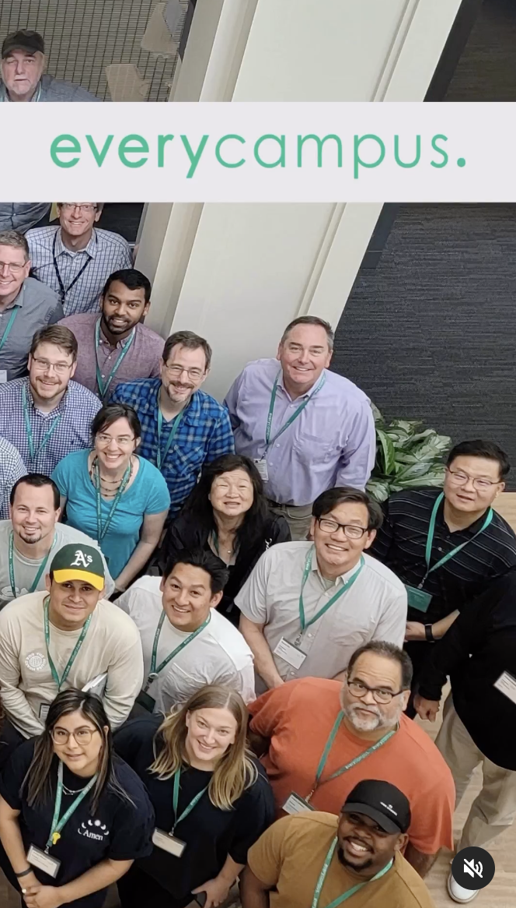

Slide 4
THE CHALLENGE PT. 2
Reaching the campuses for Christ – knowing the needs of this generation
How to pray with this generation
Biblical reminders of why we focus on prayer for this generation

Slide 5
THE CHALLENGE PT. 2
Reaching the campuses for Christ – knowing the needs of this generation
How to pray with this generation
Biblical reminders of why we focus on prayer for this generation

Slide 6
REACHING THIS GENERATION:
KNOWING WHAT CAUSES ARE IMPORTANT
Environment
Mental Health
Racial and Gender Equity
Gun Control
Economic Concerns
https://unitedwaynca.org/blog/gen-z-social-issues/
Hearing about revival from Asbury University in Kentucky

Slide 7
THE CHALLENGE PT. 2
Reaching the campuses for Christ and prayers for needs of this generation
How to pray with this generation
Biblical reminders of why we focus on prayer for this generation

Slide 8
HOW TO PRAY WITH THIS GENERATION:
Embodying humility by being open to the work of God by the Holy Spirit and
inviting God to open hearts to extend trust and follow-up regardless of age
Include meaningful worship
Plan short prayer segments of prayer based on worship/scripture
Focus on meaningful topics for the age group
Mentor a younger person to lead
https://www.prayerleader.com/engaging-millennials-and-gen-zs-in-group-prayer/

Slide 9
THE CHALLENGE PT. 2
Reaching the campuses for Christ and prayers for needs of this generation
How to pray with this generation
Biblical reminders of why we focus on prayer for this generation

Slide 10
THE CHALLENGE PT. 2
Jesus prays for us…
John 17:23 I in them and you in me—so that they may be brought to complete unity. Then the world will know that you sent me and have loved them even as you have loved me. (Unity)
Ezekiel 36:26, “I will give you a new heart and put a new spirit in you; I will remove from you your heart of stone and give you a heart of flesh. And I will put my Spirit in you.” (revival)
I Thess 5:16-18 Rejoice always, pray continually, give thanks in all circumstances; for this is God’s will for you in Christ Jesus.

