Slide 1
Lead Me Great Jehovah
Lead Me Thou Great Jehovah
https://www.youtube.com/watch?v=L2QvFKKCzzs
Christ Forevermore
https://saddleback.com/visit/locations/onlinecommunity/watch?autoplay=true 14:20-18:23 minutes

Slide 2
Prayer and Guidance

Slide 3
Prayer and Guidance

Slide 4
Prayer and Guidance
Dr. Rick Durst
Senior Professor of Historical Theology
Gateway Seminary, Ontario CS

Slide 5
Prayer Discipleship: The Great Omission
Listening for God’s voice.
1 Sam. 3:19-20

Slide 6
“Go and lie down,” he said to Samuel, “and if He calls you, say, ‘Speak, LORD, for Your servant is listening.’ ” 1 Sam. 3:9

Slide 7
“Samuel grew, and the LORD was with him, and He fulfilled everything Samuel prophesied.”1 Sam. 3:9

Slide 8
When we listen, God speaks.
When we obey promptly, God acts.
When God acts and fulfills, people are changed.
When people change, the nation changes.
Paraphrased from Mary Geegh, God Guides

Slide 9
Prayer Discipleship: How to Talk with God
Adoration and Praise (Rather than His attributes of greatness & goodness we jump to Thanksgiving)
Confession (should include Lamentation)
Thanksgiving and Gratitude
Supplication (Petition and Intercession)

Slide 10
Prayer Discipleship: The Great Omission
Guidance: Listening for God’s voice.
1 Sam. 3:19-20

Slide 11
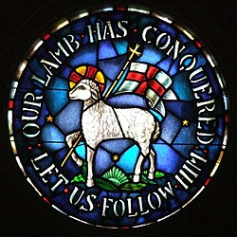
Prayer, Guidance & Mission
The Moravian Mission work started after a 1727 Prayer Awakening at Herrnhut (the Lord’s Watch) in Germany. It sparked a 24/7 prayer meeting that lasted 100 years!

Slide 12
Prayer Discipleship: The Great Omission
Research into the 100 Year Prayer Meeting undergirding the Moravian Missions Movement revealed that what was most often prayed for by far: Guidance.

Slide 13
Not Omitted in Muslim Discipleship
Ishtikhara is the non-obligatory prayer for guidance from Allah.

Slide 14
Recall the opening words in the prayer discipleship of Jesus.

Slide 15
Our Father in heaven, hallowed be your name. Your kingdom come, your will be done.

Slide 16
Hallowing the name has this missional context in Ezekiel: before the nations. Ez. 20:41; 28:22,25; 39:25,27

Slide 17
“Kingdom come” and “will be done” are the commitments of the listener to promptly obey.

Slide 19
Prayer Discipleship: The Great Omission
Listening for God’s voice.
1 Sam. 3:19-20

Slide 21
1. Listen quietly 2. Repent quickly 3. Write down & obey promptly and fully. 4. Tell others what happens

Slide 22
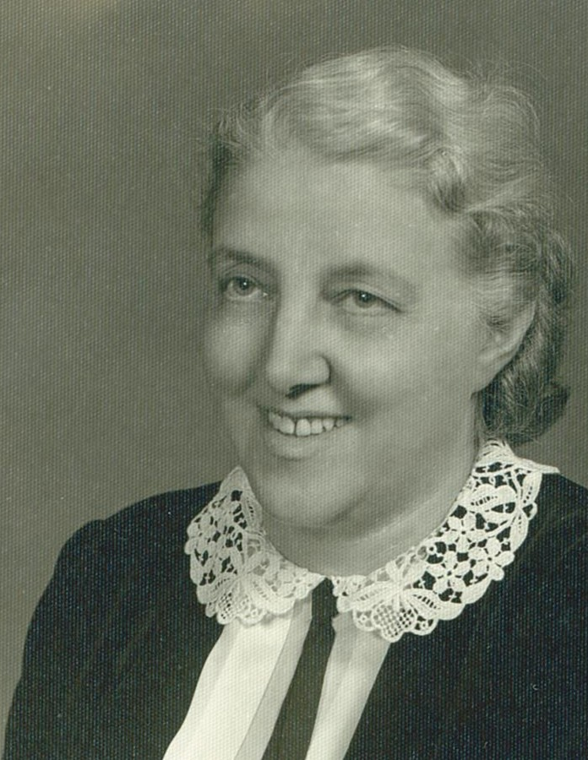
1. Listen quietly 2. Repent quickly 3. Write down & obey promptly and fully. 4. Tell others what happens

Slide 24
We are made for connection with God and others. When we experience that connection, our lives are redeemed.

Slide 25
“If any of you lacks wisdom, you should ask God, who gives generously to all without finding fault, and it will be given to you.” James 1:5

Slide 26
Resources In Search of Guidance, Dallas Willard, 1993 God Guides, Mary Greegh, 1900 Created for Connection, Sue Johnson and Kenneth Sanderfer, 2016

