Slide 1
Reaching GenZ

Slide 2
Reaching GenZ
(born after 1995)

Slide 3
The Fastest Growing Religious Group
in America

Slide 4
The Fastest Growing Religious Group
in America
The Nones or Nothings

Slide 5
The Fastest Growing Religious Group
in America
The Nones or Nothings
Not Agnostics
Not Atheists

Slide 6
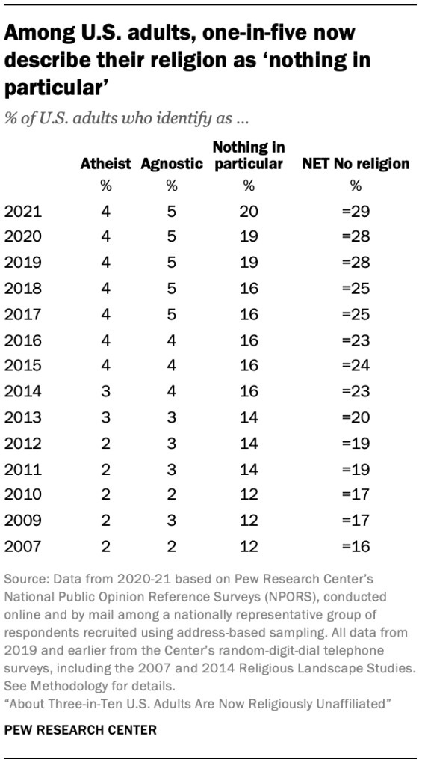

Slide 7
The Fastest Growing Religious Group
in America
The Nones or Nothings
Not Agnostics
Not Atheists
As in
Not Interested
No Comment

Slide 8
The Fastest Growing Religious Group
in America
The Nones or Nothings
Not Agnostics
Not Atheists
As in
Not Interested
No Comment
It’s ok for you,
but it’s not for me

Slide 9
Another Problem We Face

Slide 10
Another Problem We Face
From The Barna Group
“almost half of Millennials (47%) agree at least somewhat that it is wrong to share one’s personal beliefs with someone of a different faith in hopes that they will one day share the same faith.”
The Barna Group, February 5, 2019, Almost Half of Practicing Christian Millennials Say Evangelism Is Wrong, Accessed March 5, 2020, https://www.barna.com/research/millennials-oppose-evangelism/.

Slide 11
Where is GenZ’s Hope?

Slide 12
Where is GenZ’s Hope?
Techno Optimism

Slide 13
Where is GenZ’s Hope?
Techno Optimism
Published in 2013, Infinite Progress: How the Internet and Technology Will End Ignorance, Disease, Poverty, Hunger, and War by Byron Reese

Slide 14
Where is GenZ’s Hope?
Techno Optimism
Published in 2013, Infinite Progress: How the Internet and Technology Will End Ignorance, Disease, Poverty, Hunger, and War by Byron Reese
Orville Wright, 1917, “the aeroplane will help peace in more ways than one–in particular I think it will have a tendency to make war impossible.”

Slide 15
The Challenge Before Us
A generation that has little or no interest in our message
GenZ believers who have little or no interest in reaching their peers
An immensely popular and powerful idolatry

Slide 16
Our Hope
There has never been
a generation that
God does not love and has not been
able to reach

